Slide 1
Sales Patterns Analysis for Ireland Brewery Subsidiary
Presenter: Adesokan Janet

Slide 2
Goal
To conduct a comprehensive analysis of sales performance across months, regions, and brands, uncovering seasonal trends and drivers of profitability, and providing actionable insights for strategic decision-making.

Slide 3
Introduction and Objectives Slide:
Objective 1: Identify seasonal trends in sales.
Objective 2: Assess regional and brand contributions to overall performance.
Objective 3: Explore relationships between sales, profitability, and cost.
Objective 4: Provide strategic recommendations for maximizing growth.

Slide 4
Key Metrics
Total Sales Performance
Overall Total Sales: $242M (cumulative across the dataset).
Region with highest sales: South-South- $40.8M
Top-Performing Brands by Revenue (2017–2019): Budweiser: $63.1M
Market Share of Top Brands: Clearly dominated by Budweiser and Castle Lite
Sales by Month: Peak sales months: March, February, November.
Lower sales months: April, September, October.

Slide 5
Country with highest Profit margin: Nigeria: 43.7%
Plant Costs and Profits: Costs peaked in 2017 but declined in subsequent years.
Average Cost by Country: Nigeria: $152.86
Best Sales Representatives: Howard Jones and Morgan Jardine excelled across 2017–2019
Top Three Brands by Country: Budweiser, Castle Lite, and Eagle Lager dominate across all countries. Hero and Trophy appear as key contributors in some regions.

Slide 6
Seasonal Trends Slide
Sales by Month: Peak sales months: March, February, November.
Lower sales months: April, September, October.

Slide 7
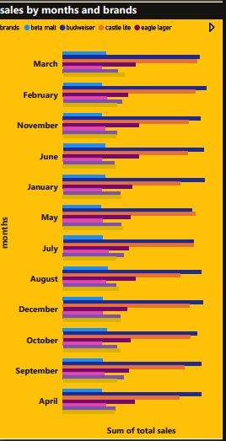

Slide 8
Profitability Metrics
Average Cost by Country:
Nigeria: $152.86
Senegal: $153.16
Benin: $153.21
Ghana: $152.86
Togo: $152.87
Profit Margins by Country:
Nigeria: 43.7%
Senegal: 43.68%
Benin: 43.65%
Ghana: 43.62%
Togo: 43.60%

Slide 9
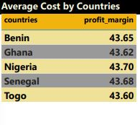
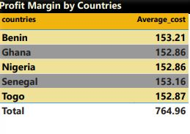

Slide 10
Trends Over Time (2017–2019)
Sales Growth/Decline:
2017: $87.1M
2018: $70.3M
2019: $84.5M
Plant Costs and Profits:
Costs peaked in 2017 but declined in subsequent years.
Profit trends align with total sales, showing consistent relationships.

Slide 11
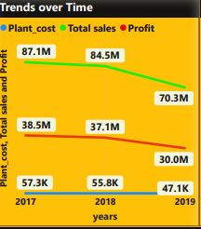

Slide 12
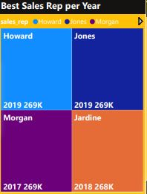
Best Performers: Howard, Jones, Morgan & Jardine excelled across 2017–2019

Slide 13
Geographic Sales Patterns
Budweiser, Castle Lite, and Eagle Lager dominate across all countries.
Hero and Trophy appear as key contributors in some regions

Slide 14
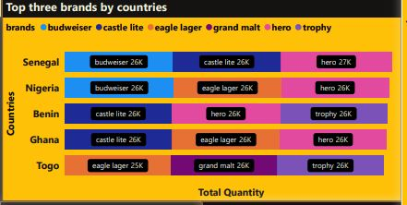

Slide 15
Strategic Recommendations :
Actionable strategies should be taken such as:
Focusing marketing efforts during peak months.
Strengthening distribution networks in high-performing regions.
Promoting underperforming brands during off-peak seasons
Scaling back production for loss-making brands.
Enhancing distribution in high-performing regions.

Slide 16
Strategic Recommendations
Reduce production or marketing for loss-making brands.
Focus on high-performing regions/brands.
Introduce targeted promotions for underperforming months.
Optimize costs in regions with high sales but low profit margins.

Slide 17
